Slide 1
Java Masterclass Project

Slide 2
Module Summary
Day 1: Java Fundamentals
Day 2: Using and Connecting to Database
Day 3: Java Spring Boot API
Day 4: Front-End Web Application (Angular)
Day 5: Selenium Testing and Docker Deployment

Slide 3








Slide 4

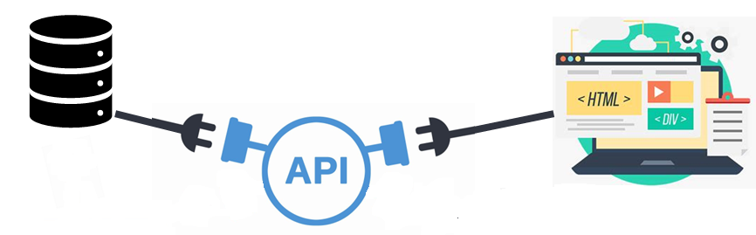


Slide 5
Group Work
We will divide the class into 3 groups, each with 5 members.
The project can be divided into 5 parts:
  Database (Backend)
  Java Desktop App
  Spring Boot API
  Front-End Web App (Angular)
  Automated Testing and Dockerization
Each group needs to build a system that integrates all the aforementioned components.
Matrix for checking:
Requirement | Database | Java Desktop App | Spring Boot API | Frontend Web App | Testing and Containerization | Subtotal
System | 10 | 10 | 10 | 10 | 10 | 50
Question | 10 | 10 | 10 | 10 | 10 | 50
 |  |  |  |  | TOTAL | 100

Slide 6
Group Work
The project is an integration of 5 components.
Each group must assign a leader
Each group can delegate corresponding members to work on each of the 5 components
The leader will then present (screen share) how their system works (15mins).
The member delegated to the component will be responsible in answering the questions related to that component.
Each member will only need to answer 2 questions for each component.
The questions will be asked on the day of checking.
Each question weighs 5pts, which makes 10pts gained FOR EACH component if you got the correct answer. And a grand total of 50pts for getting all the correct answers for all the categories.
Questions asked will only come from the class discussions. “If it was not discussed, it will not be asked”.
The total points obtained by the group will be the score of each of the members.
Passing score is 80pts.

